Slide 1
Go-back-N

Slide 2
The Problem with Stop & Wait
Transmission and Propagation of a frame and the corresponding ACK take time
During this time, the sender is idle
Link Under-utilisation

Slide 3
Example
50 Kbps satellite channel
500 msec round-trip propagation delay.
To send a 1000 bit frame using Stop & Wait:
t = 0: the sender starts the first frame
t = 20 msec: the frame has been completely sent.
t = 270 msec: the frame has fully arrived at the satellite.
t = 520 msec: the acknowledgment has arrived at the sender. (assuming the ACK can be transmitted instantly)
Sender was blocked 500/520 or 96% of the time.
One-Way link utilisation (From host to satellite) at 4%

Slide 4
Pipelining
Allow sender to send W frames in a row before waiting for an ACK.

Slide 5
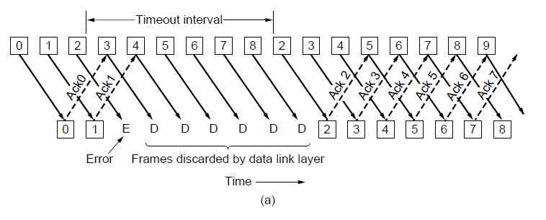
Protocol Using Go-Back-N
Receiver only accepts frames that arrive in order
Frames that arrive after a missed/errored frame are discarded
Sender times-out and resends all outstanding frames (Hence the name)

Slide 6
How do we count frames?
We need frame sequence numbers in the header
Sequence number space:
We need W+1 sequence numbers in [0, W]
Therefore we need b bits in the header such that 2^{b} ≥ W+1
Example: For W=7 we need 3 bits, and the sequence number space will be 0…7

Slide 7
Pipelining
Very simple receiver implementation
What’s a good value for W?
Large W: Good link utilisation
More buffer space required
More wasted frames when error occurs Entire window has to be retransmitted

Slide 8
Pipelining Calculations
Assuming:
Fixed frame size
Instant transmission of ACKs Think: zero-sized ACKs
Then we need W = 2*BD+1, where BD is in units of frames.

